Slide 1
Test-Driven Development (TTD) in Django
Ravikanth
Technical Architect
Mindlabs - Open-Source

Slide 2
Agenda:
Introduction
Why TTD
Benefits of TTD
Approaches
Sample work flow
Conclusions

Slide 3
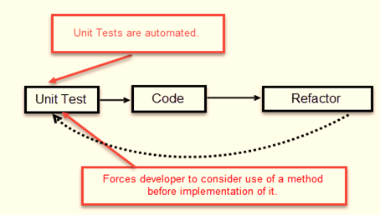
Introduction
Test-Driven Development starts with designing and developing tests for every small functionality of an application.
In TDD approach, first the test is developed which specifies and validates what the code will do

Slide 4
Why TTD ?
They save an enormous amount of manual troubleshooting time
Change in one part of your application will break another part
Helps to verify that changes you make to one part of the software do not break another.

Slide 5
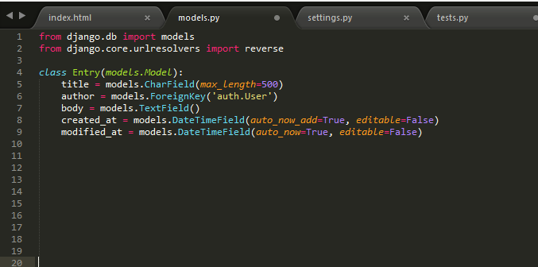
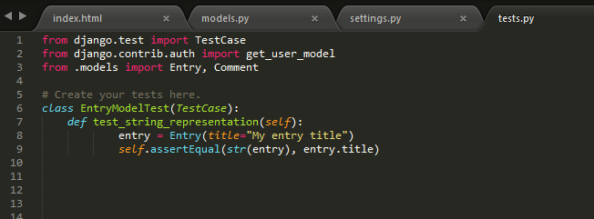
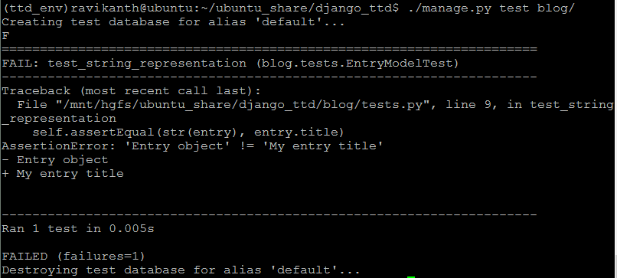
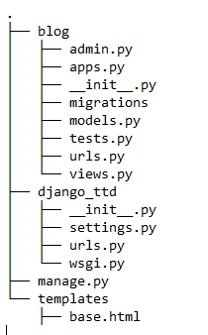

Slide 6
